Slide 1
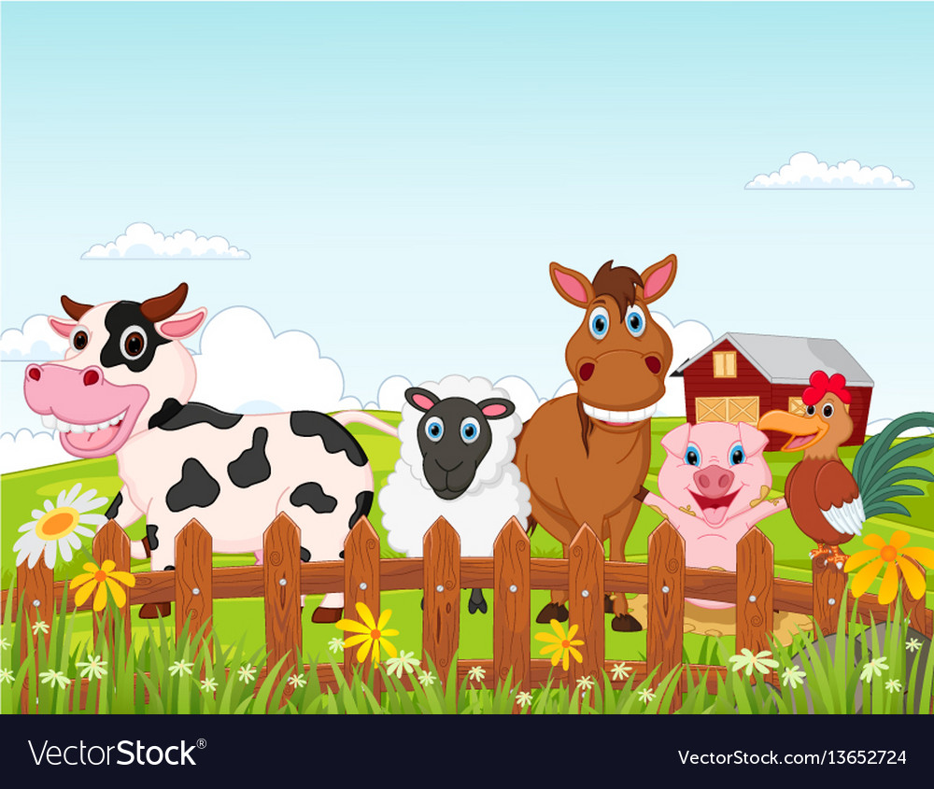
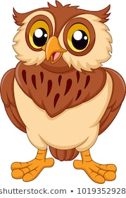
Communication and Language
Songs and Rhymes
Recap on Rhymes learnt in previous years:
Baa Baa Black Sheep, Incy Wincy Spider, Wind the Bobbin Up, Twinkle Twinkle, Round and Round the Garden, Row Row Row your Boat, I’m a dingle dangle Scarecrow, Two Little Dickie Birds, I’m a little Teapot, Tommy Thumb, 1,2,3,4,5 Once I Caught, Heads Shoulders Knees and Toes, Old Mcdonald, If you’re Happy, The Wheels on the Bus, One Finger One Thumb
Listen with increasing attention, join in with stories & poems
Use talk to give meaning, to explain & to connect ideas
Build up vocabulary & use widening range of words
Show interest, hold & handle books correctly & carefully
Use 1-handed tools & manipulate with increasing control & co-ordination
Physical Development
PD/Outdoor ongoing
Move freely, expressing feeling, judging special awareness & showing respect for others personal space
Show increasing control in holding position & using equipment to climb, scramble, slide
Persevere in developing new skills and repeating actions
Collaborate with others in tasks and in following rules.
Show a preference for a dominant hand
Can copy some letters
Personal Social and Emotional development
Be able to separate with confidence
Show acceptance of the needs of others and show care for others and for living things and the environment
Seek out others to share experience, linking up for
guidance and support
Show willingness to tackle problems, take initiatives and manage developmentally appropriate tasks
Show increasing independence in carrying out activities
Settling in and
Farm
Mathematics
Maths lessons will be individually planned for each child to ensure their needs are being met. They can include lessons like:
Songs and Rhymes
Counting objects to 10
Match number cards to numbers and/or amounts
Show interest in counting and in number problems
Use size language big/medium/ small/tall/short...to differentiate and describe
Recognise and talk about 2D and 3D shapes in the environment & in construction activities
Understanding the World
Show interest in the world they live in, question & comment on the natural world
Differentiate between past & present, showing awareness of change & describing events concerning themselves & their family and friends
Understand tools can be used for a purpose & use range of tools & techniques
Operate simple equipment
Literacy
Owl Babies (T4W) and other quality texts will be read daily
Enjoys rhyming and rhythmic activities.
Listens to and joins in with stories and poems, one-to-one and also in small groups.
Beginning to be aware of the way stories are structured.
Listens to stories with increasing attention and recall.
Shows interest in illustrations and print in books and print in the environment.
Recognises familiar words and signs such as own name and advertising logos.
Looks at books independently.
Gives meaning to marks as they draw and paint.
Expressive arts and design
Role play area – introduce story lines, take on roles, play cooperatively
Songs and Rhymes
Finger/hand/foot prints
Action dances, Body sounds and rhythms
Owl Room
Autumn

